Slide 1
Particle Accelerators

Slide 2
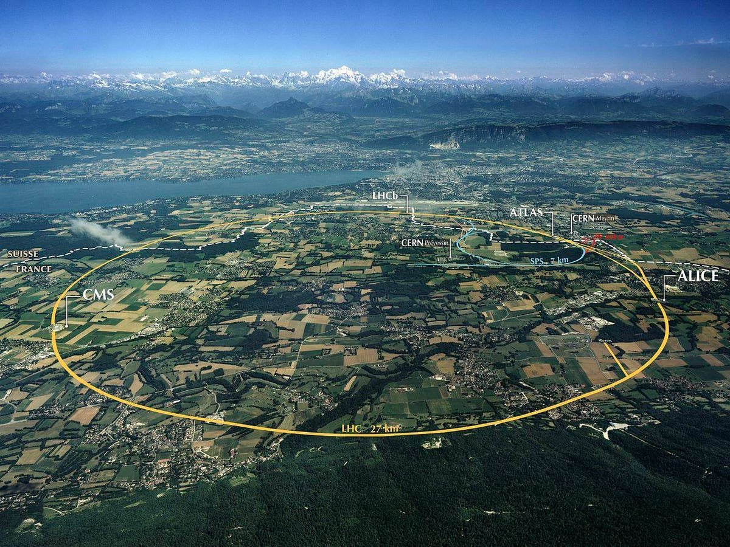
Testing the Standard Model
Like all theories, the Standard Model of particle physics required testing and data to be validated and refined – but since the vast majority of matter consists of just three particles (u, d, e⁻), this was a significant challenge.
To create the high-energy systems in which a wider variety of particles can be observed, physicists use particle accelerators to fire particles at each other at relativistic speeds.
When these particles collide, their total energy is conserved, but only some of it remains as kinetic energy. Due to mass-energy equivalence, new particles (with more mass than the ones that entered the collision) can be formed.
The Large Hadron Collider (LHC), 45-170 m beneath the France-Switzerland border

Slide 3
Linear Accelerators
The simplest particle accelerators are linear accelerators (or linacs for short). A linac consists of:
A vacuum chamber (to prevent unwanted collisions)
An ion source
A series of drift tubes of increasing length with gaps between them
A high-frequency AC source (also known as a radio-frequency oscillator or RF oscillator)
The oscillator is configured in such a way that the particles experience an electric force in the same direction in every gap between the drift tubes.

Slide 4
Example #1
Explain why a linac’s drift tubes are longer the further away from the ion source they are.
Explain why, contrary to this pattern, the drift tubes towards the end of a linac are all approximately the same length as each other.

Slide 5
Example #2
A linac-based electron microscope uses a single stage 300 kV potential to accelerate slow moving electrons released by thermionic emission for a tungsten filament. Calculate the speed of these electrons.
Notes:
Use W = Vq to determine kinetic energy gained, assuming initial velocity is negligible (4.80 × 10⁻¹⁴ J)
Use E_{t} = E_{k} + E_{rest} to find total energy (1.2999 × 10⁻¹³ J)
Use mass-energy equivalence formula to find v (= 2.33 × 10⁸ m s⁻¹)

Slide 6
Linear Accelerators
Linacs need to be very long to achieve useful speeds, so they are generally used on stationary targets. This is most helpful in nuclear physics experiments.
They are less useful in particle physics since they struggle to produce very massive particles.
This is a consequence of conservation of momentum: when the accelerated particles collide with the target particles, the target particles must start moving, meaning that a significant portion of their energy must be kinetic (therefore not contributing to their rest energy/mass).
Notes:
Note that we still managed to detect various leptons / quarks and determine the structure of protons / neutrons with linacs.

Slide 7
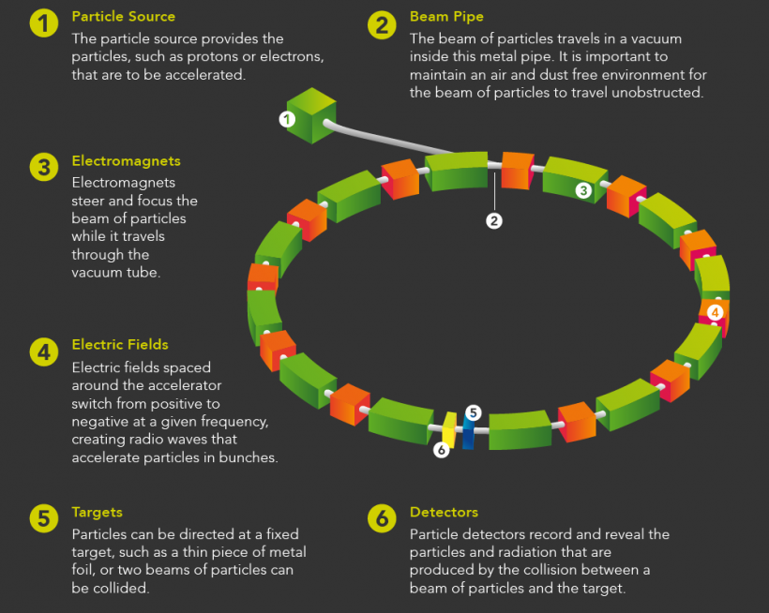
Synchrotrons
Synchrotrons are circular particle accelerators capable of much higher particle speeds than linacs. They are also capable of aiming two particle beams at each other, creating head-on collisions with a total momentum of approximately zero.
Since almost all of the energy that goes into the collision becomes rest energy, heavier particles can be formed.

Slide 8


Slide 9
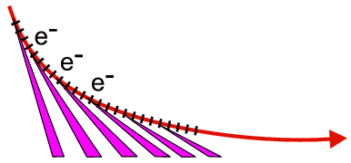
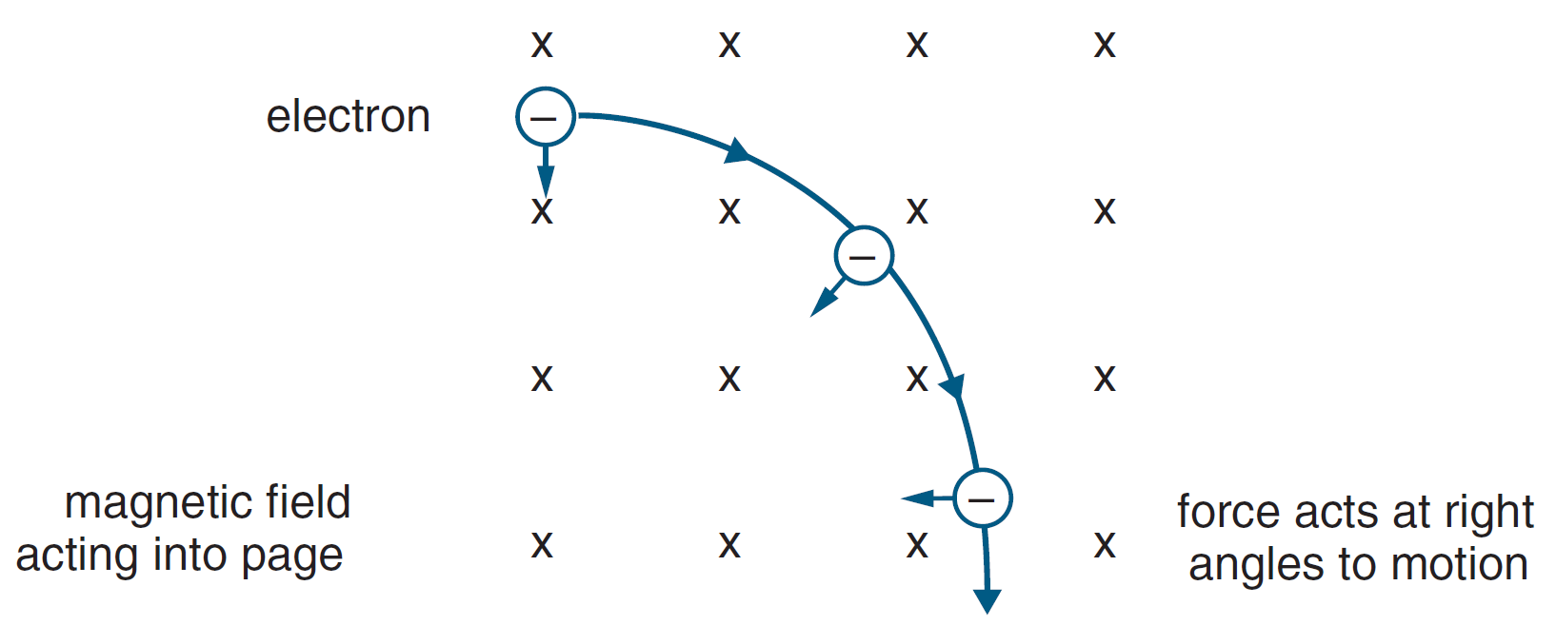
Synchrotrons
Synchrotrons have a series of acceleration cavities, which function like the gaps between a linac’s drift tubes: they use electric fields to accelerate the particles.
Between the acceleration cavities are bending magnets, which keep the particles moving in circular paths.
As with any accelerating charged particle, electromagnetic radiation (known as synchrotron radiation) is emitted as the particles are ‘bent’. This energy loss slows the particles down, so they require constant acceleration to maintain their speed.

Slide 10
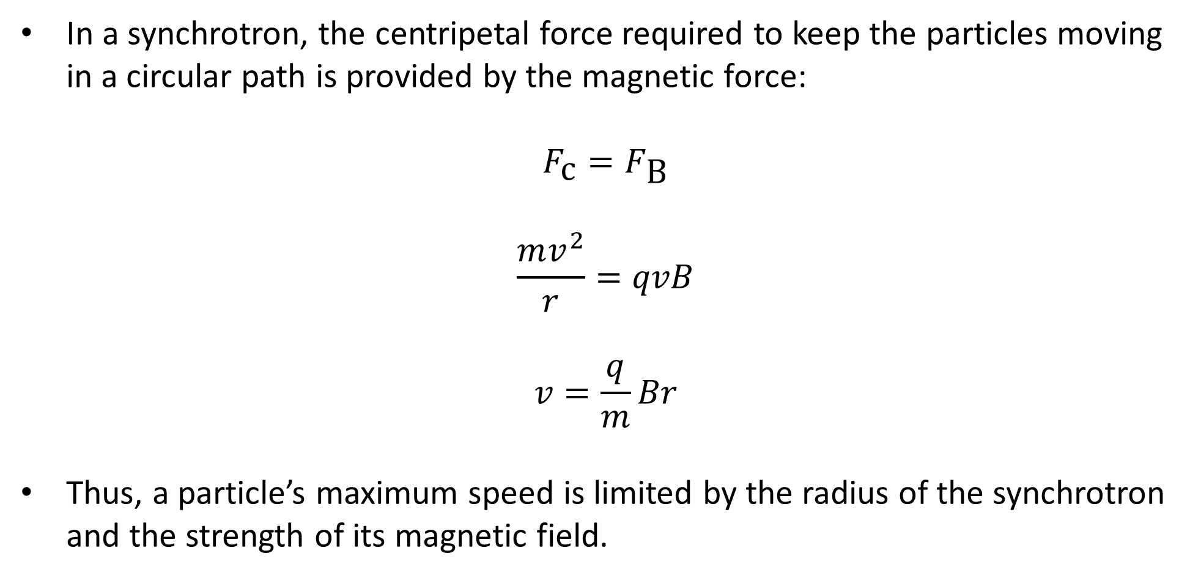
Synchrotrons
In a synchrotron, the centripetal force required to keep the particles moving in a circular path is provided by the magnetic force:
$$F_{\text{c}}=F_{\text{B}}$$
$$\frac{mv^{2}}{r}=qvB$$
$$v=\frac{q}{m}Br$$
Thus, a particle’s maximum speed is limited by the radius of the synchrotron and the strength of its magnetic field.
Notes:
This is given in the electromagnetism section of your formula sheet as an expression for r (= vm/qB)

Slide 11

Example #3
A 67.0 m wide synchrotron storage ring holds 32.0 GeV antiprotons.
Draw in the magnetic field required to keep the antiprotons rotating within the ring as shown below.
Calculate the magnetic flux density required to keep the antiprotons within the ring.
Notes:
Use relativistic E_{t} to calculate v (= 0.99957c)
mv from numerator of expression for B should be calculated as relativistic momentum (= 1.708 × 10⁻¹⁷ kg m s⁻¹)
B = 3.18 T

